Slide 1
Length of Rivers Data
Lesson 5 Hands On

Slide 2
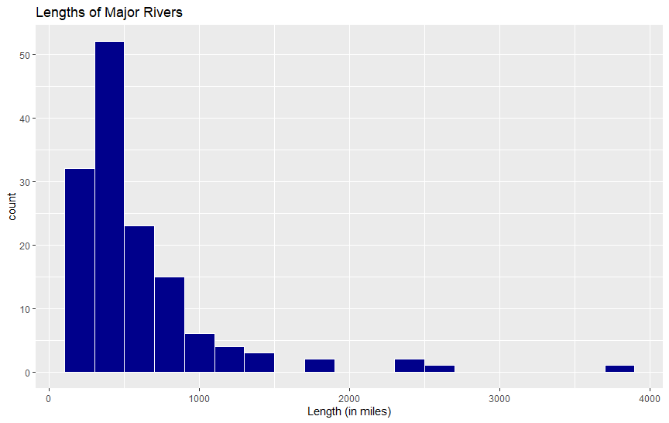
Histogram Graph
Possible problem child for normal distribution...
R code:
Almost looks textbook, BUT...
#histogram
r <- ggplot(rr, aes(x = rivers))
r + geom_histogram(binwidth = 200, fill = "darkblue", color = "white") +
ggtitle("Lengths of Major Rivers") +
xlab("Length (in miles)")

Slide 3
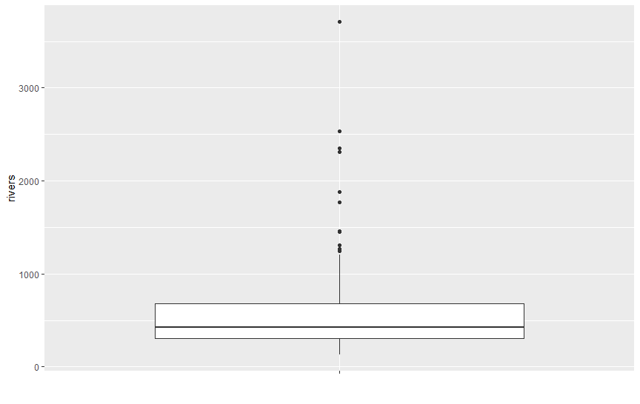
Box Plot See any outliers high or low?
High outliers, some major!
R code:
There are outliers! Let us look
#boxplot
r <- ggplot(rr, aes(x = "", y = rivers))
r + geom_boxplot() + xlab("")
summary(rr$rivers)

Slide 4
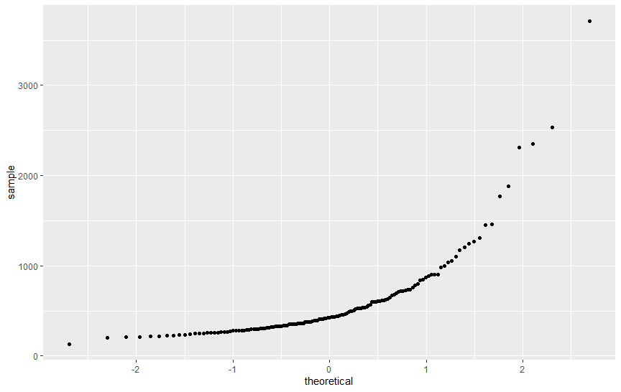
Normal Distribution Plot Does the data appear to come from a normal distribution?
Too much of a curve for normal distribution!
"Normal Distribution Line"
R code:
Almost, but not quite....
#normal probabilty plot
ggplot(rr, aes(sample = rivers)) + geom_qq()

